Slide 1
Polarity of Hashtags Using Pattern Mining
Guided by :
Dr.S.Jayanthi HOD\CSE
Submitted by :
Dharani.R 814817104008
Keerthika.N 814817104017
Ganesamoorthy.S 814817104012

Slide 2
ABSTRACT :
Hash tag is an iconic feature to retrieve the hot topics of discussion on Twitter or other social networks.
In proposed project the implementation of frequent pattern(FP) growth algorithm to identify the frequently used hash tag.
We proposed a method to classify the polarity of tweets based on Pattern mining also predict the probability of decision.

Slide 3
ISSUES AND CHALLENGES FACED IN EXISTING SYSTEM
Many social media networks like Twitter, Instagram does not able to find how many people support or against the post of any tweets by using Hashtags(#).For Example, #FarmerProtest100Days and #SpeakUpAgainstPriceRise.
But some people posting negative comment (or) feedback on some public figures in social media that projects the Particular figure in negative Manner.

Slide 4
PROPOSED SYSTEM :
This project is used to separate the Supporters and Haters who against the tweets by using frequent pattern growth algorithm and natural language processing.
With this FP growth algorithm search for frequent item set is reduced comparatively.
The NLP are used to identify the text as positive, neutral or negative. Which deals with the interaction between computers and human using the natural language.
To identify original frequency of tags and finding meaning of tags.

Slide 5
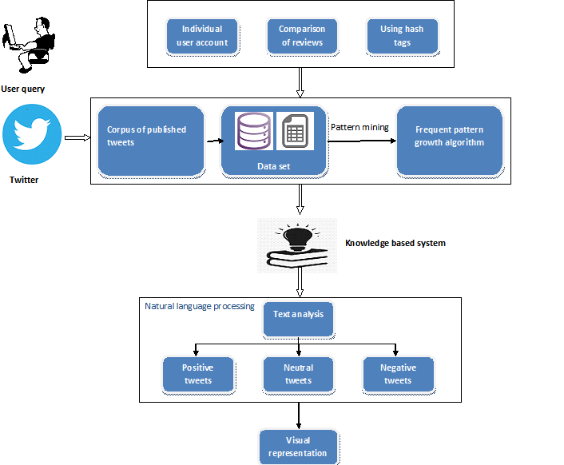
SYSTEM ARCHITECTURE :

Slide 6
SOFTWARE REQUIREMENTS :
Operating System : Windows 7 /10
Software : Python 3.8 / above
HARDWARE REQUIREMENTS :
Processor : Pentium-IV
RAM : 2 GB
Hard Disk : 20 GB

Slide 7
MODULE SEPARATION :
GUI.
Twitter Developer login.
Data Collection.
Cleanup Tweets.
Natural Language Processing.
Decision.

Slide 8
MODULE SPECIFICATIONS
1.GUI
Tkinter is a GUI Toolkit for creating User friendly Interfaces.
Fast Simple and reliable.
It’s a cross platform toolkit which supports windows, Mac and Linux.
Here we are using GUI toolkit for getting user queries.

Slide 9
2. Twitter Developer login
The first step for this project is to apply for a twitter developer account.
Twitter will provide a unique access token and access token secret key using this keys.
These keys can be used for the API Authentication.

Slide 10
3.Data Collection
After authentication, we can either collect tweets by a particular user or by a hashtag by using the TweetPy Module.
Then the captured content are stored together as dataset.
The datasets are text file saved as table structured format called CSV(comma separated values) file.
The frequent items in dataset are separated by using FP-Growth algorithm.

Slide 11
4.Cleanup Tweets
For getting better result in Natural language processing, we need to clean tweets,
Remove Links,
Remove Hashtags,
Remove Retweets,
Remove URL’s,
Spelling correction,
Grammatical Error Correction.

Slide 12
5.Natural Language Processing
NLP(Natural Language Processing) is used to classify the data from tweets.
Text blob is simplified text processing module.
Classification is the process of identifying opinions in text and labelling them as positive, negative, or neutral based on the tweets.
It can also give score for each tweet on a scale of -1 to 1.

Slide 13
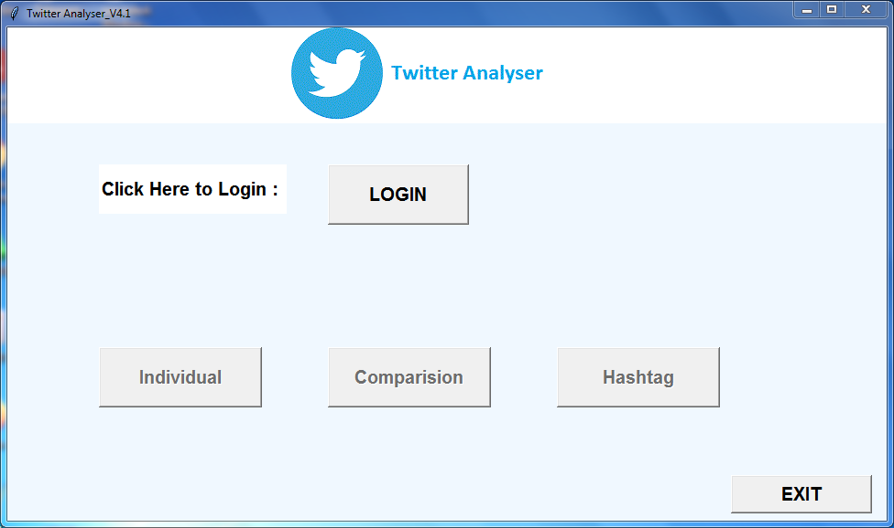
Home Screen

Slide 14
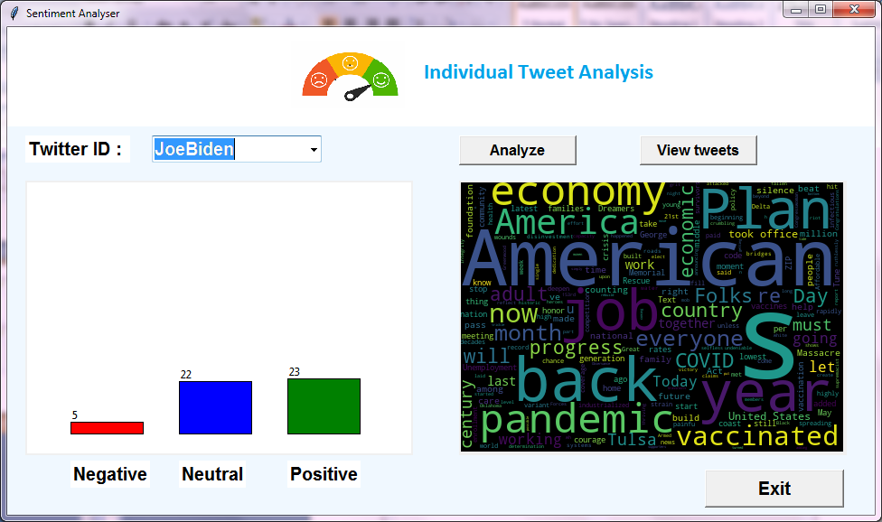
Individual Twitter ID Analysis

Slide 15
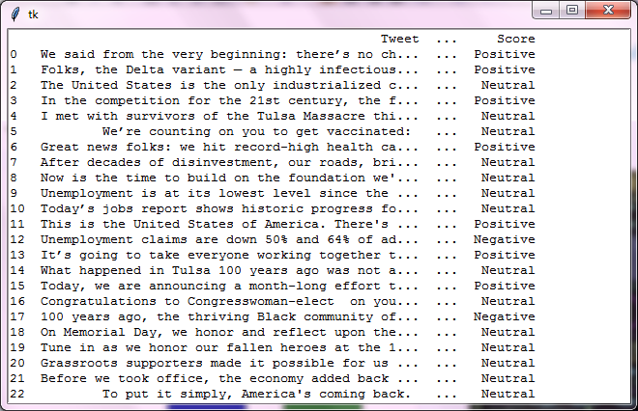
View Tweets

Slide 16
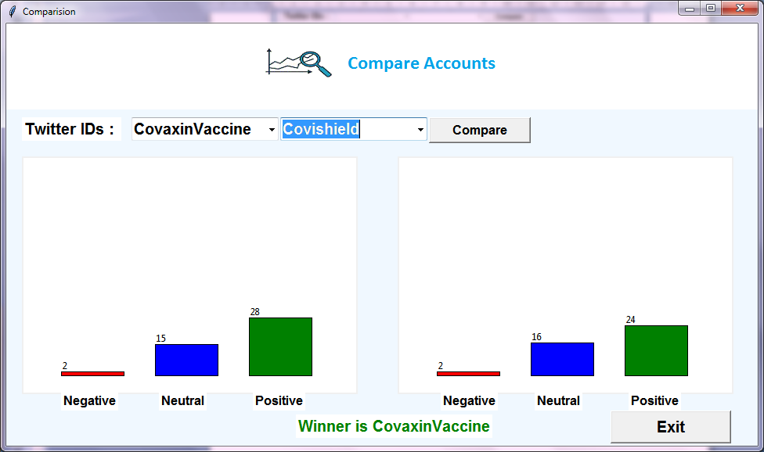
Comparison of Accounts 1

Slide 17
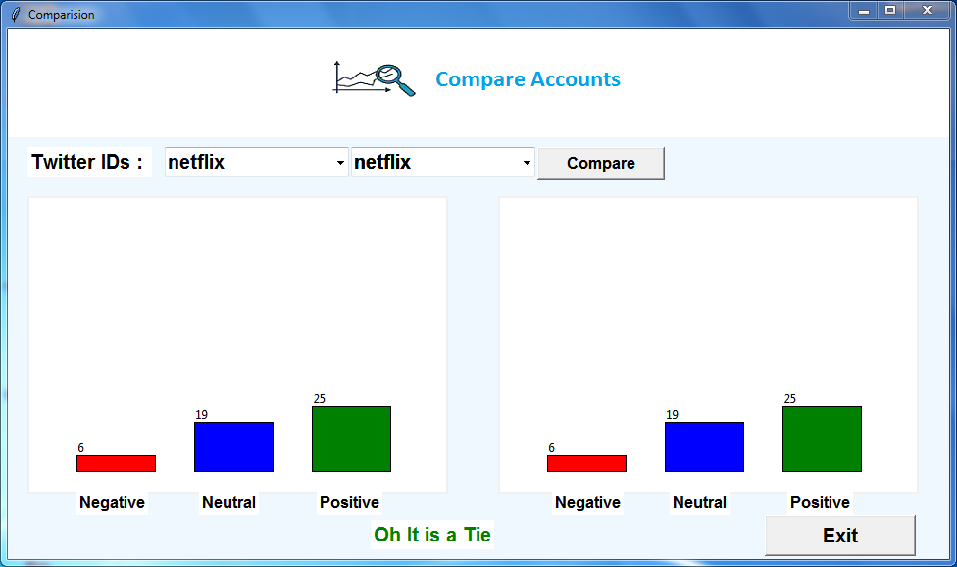
Comparison of Accounts 2

Slide 18
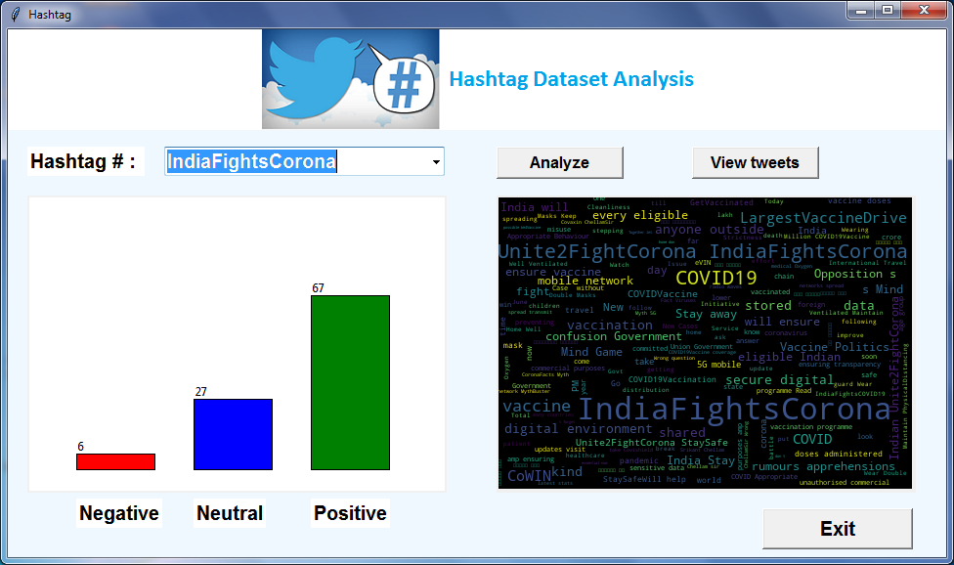
Hashtag Analysis

Slide 19
FUTURE ENHANCEMENT :
In future work, we can extend this method to implement by using various upcoming algorithms and analyse the emotions (smiles) also to extend this using various languages and multiple fields.

Slide 20
CONCLUSION :
Aimed to determine opinion of people.
About large number of dataset(positive and negative) was collected.
Normalization of dataset was done.
A simple user interface was designed.
Representation of decision.

Slide 21
REFERENCE :
[1] Asma Belhadi, Youcef Djenouri, Jerry Chun-Wei Lin, Chongsheng Zhang, Alberto Cano, “Exploring Pattern Mining Algorithms for Hashtag Retrieval Problem”, 2020.
[2] Y. Gong, Q. Zhang, and X. Huang, ``Hashtag recommendation for multimodal microblog posts,'' Neurocomputing, vol. 272, pp. 170177, Jan. 2019.
[3] G. G. Chowdhury, Introduction to Modern Information Retrieval. Facet Publishing, 2020.
[4] M. Efron, ``Hashtag retrieval in a microblogging environment,'' in Proc. 33rd Int. ACM SIGIR Conf. Res. Develop. Inf. Retr., 2020, pp. 787788.

Slide 22
REFERENCE :
[5] Cher Han Lau, Xiaohui Tao, Dian Tjondronegoro, Yue Feng. “Retrieving information for micro blog using pattern mining and relevance feedback”, 2018.
[6] J.Han, J.Rei, Y.Yin. “Mining frequent patterns without candidate generation”, 2019.
[7] Sahar A. El Rahman, Feddah Alhumaidi AlOtaibi, Wejdan Abdullah AlShehri. “Sentiment Analysis of Twitter Data”, 2019.
[8] Bharat R. Naiknaware, Seema S. Kawathekar, “Prediction of 2019 Indian Election Using Sentiment Analysis”, 2019.
[9] ZulfadzliDrus, HaliyanaKhalid, “Sentiment Analysis in Social Media and Its Application: Systematic Literature Review”, 2020.
[10] H. K. Azad and A. Deepak, "Query expansion techniques for information retrieval: A survey", Inf. Process. Manage., vol. 56, no. 5, pp. 1698-1735, Sep. 2019.

Slide 23
THANK YOU ...

